Slide 1


Simple Language Translator
By Daniel G, Yeabsira A, Yezibalem A.

Slide 2
Chapter One: Introductions

Slide 3
Introduction
Language is a system of communication which are used by the people of particular country for talking or writing.
Chapter One: Introduction

Slide 4
Objectives - General Objectives
To design bi-directional language translation for Ge’ez language to Amharic language and vice-versa.
Chapter One: Introduction

Slide 5
Objectives - Specific Objectives
To identify the syntactic relationship
Implementation and testing
To design translation AI model
Solution to the existing
Test the developed system.
Chapter One: Introduction

Slide 6
Statement of the Problem
There are a lot of historical, cultural and religious docs available in Ge’ez language
Having no regular speakers
Can’t translate at google …
Chapter One: Introduction

Slide 7
Benefits of the Project
Can understand, research on Ge’ez language and in return grow the economy of the country.
Chapter One: Introduction

Slide 8
Limitation of the Project
Not support searching words by voice.
It may not provide accurate translations
It only translates 2 languages.
Chapter One: Introduction

Slide 9
Scope of the Project
Translates words and sentences
Allows view about us info.
Learn about Ge’ez language.
Shows the setting of the app.
Chapter One: Introduction

Slide 10
Methodology
Requirement gathering
Googling and doc analysis
Analysis and design - OO
Implementation - OO Programming
Chapter One: Introduction

Slide 11
Feasibility Study
Technically, economically and timely feasible
No internet need to use the app except using web
Available on 6 platforms
Chapter One: Introduction

Slide 12
Chapter Two: System Features

Slide 13
Existing System
Dictionary, Google translator, Yandex
Dictionary
Multilingual Translation
Free limited API
Chapter Two: System Features

Slide 14
Proposed System
Flutter framework - available on 6 platforms:
Linux, iOS, MacOS
Windows, Android
Web
Chapter Two: System Features

Slide 15
Requirement Analysis
Setting of the application.
Learn about Ge’ez language.
View about us page.
Share application.
Translate words and sentences.
Chapter Two: System Features

Slide 16
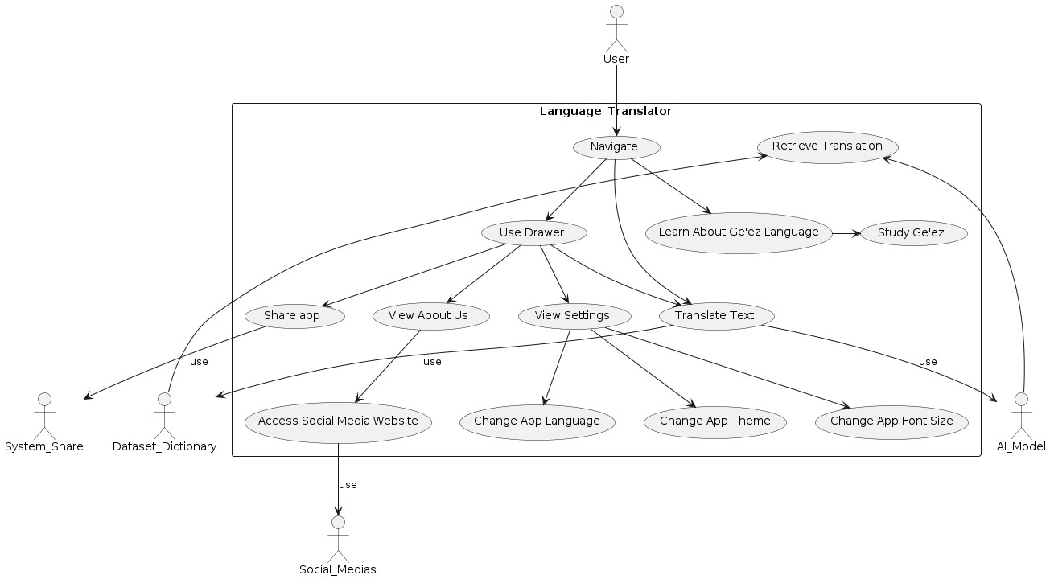
Req. Analysis- Use Case Diagram
Chapter Two: System Features

Slide 17
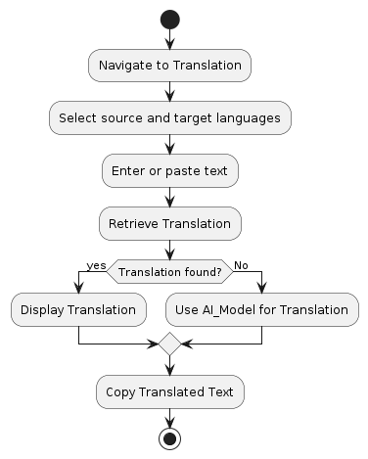
Activity Diagram
Chapter Two: System Features

Slide 18
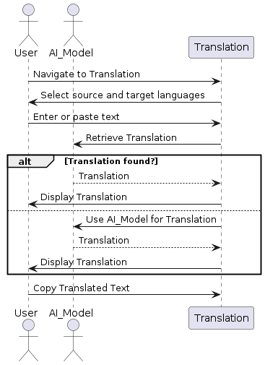
Sequence Diagram
Chapter Two: System Features

Slide 19
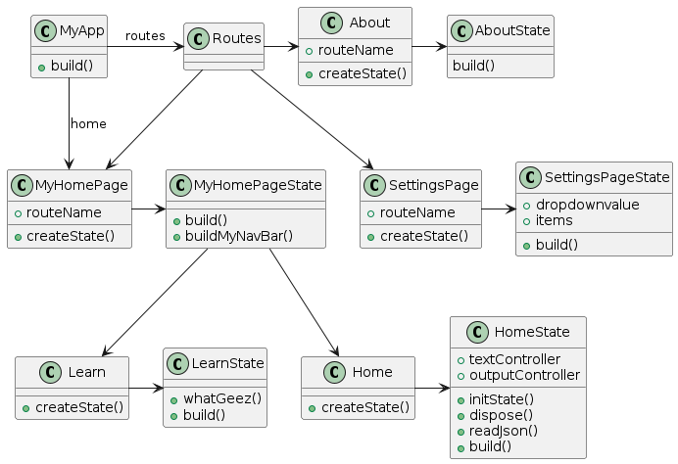
Class Diagram
Chapter Two: System Features

Slide 20
Chapter Three: System Design

Slide 21
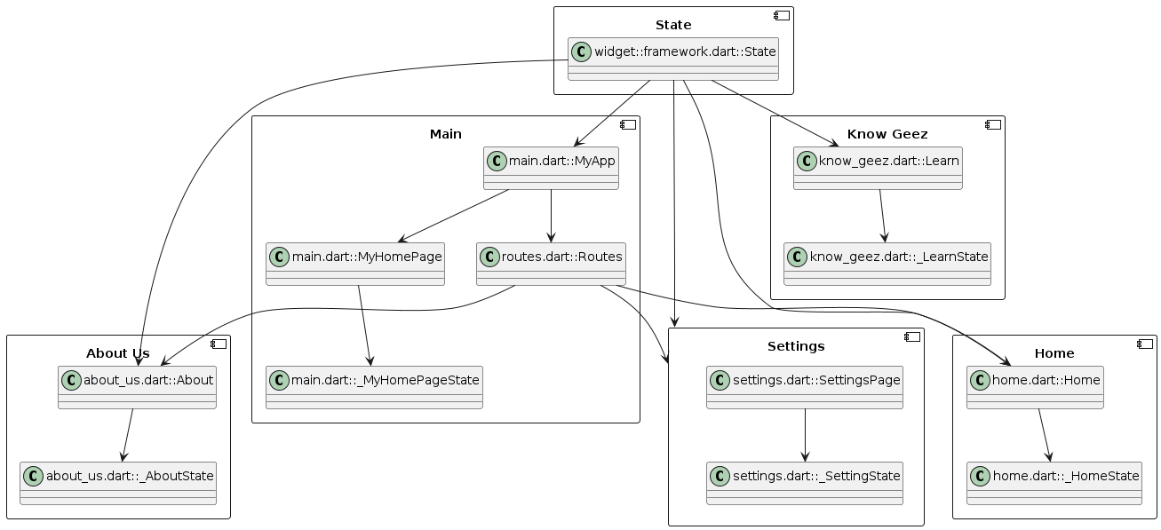
Architectural Design - Component
In this chapter, we design the system with real worlttttttd solution
Chapter Three: System Design

Slide 22
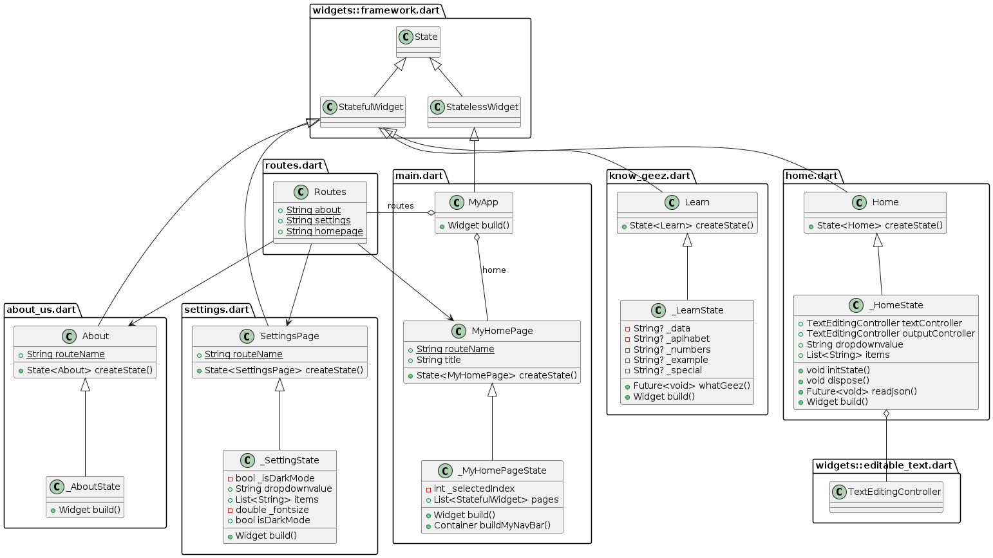
Detail Design: Class Diagram
Chapter Three: System Design

Slide 23
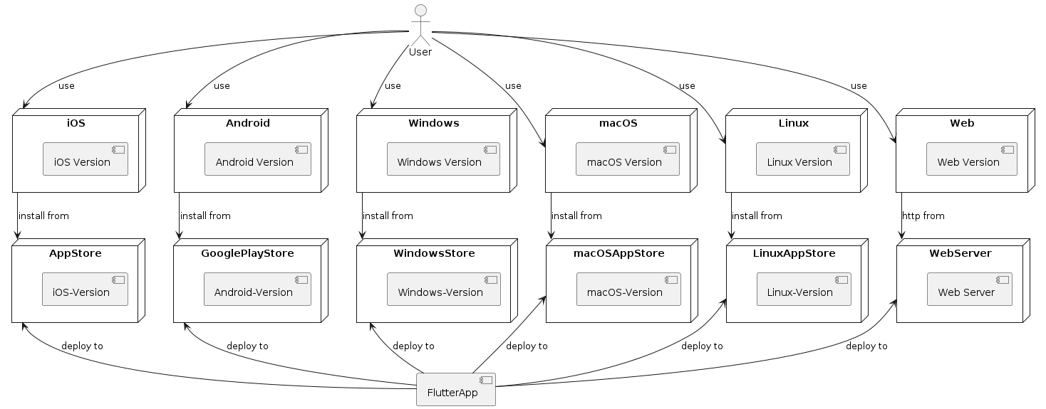
Deployment Diagram
Chapter Three: System Design

Slide 24
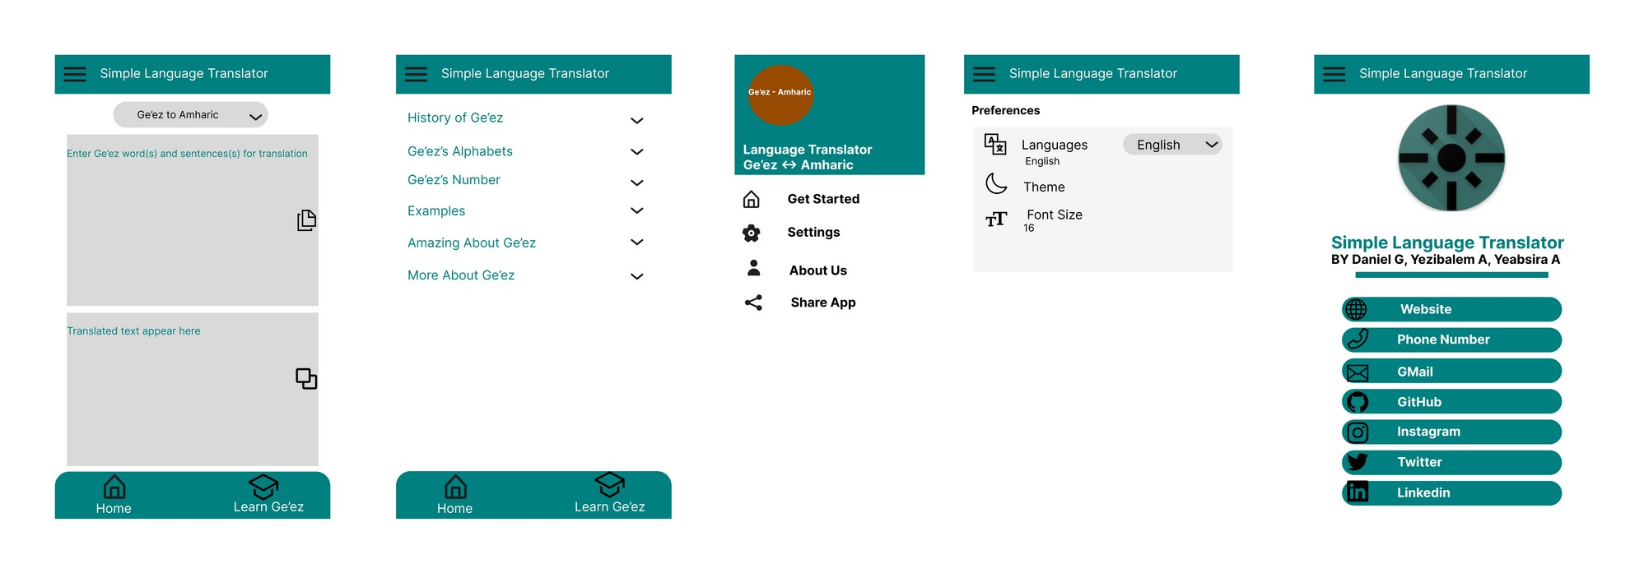
User Interface Design
Chapter Three: System Design

Slide 25
Chapter Four: Implementation
// Fetch content from the json file
Future<void> readJson() async {
final String response = await rootBundle.loadString('assets/files/geez_amharic.json');
Map lang = await json.decode(response);
}
lang.forEach((key, value) {
if (dropdownvalue == "Ge'ez to Amharic") {
if ('$key' == textController.text) {
outputController.text = '$value';
}
} else {
if ('$value' == textController.text) {
outputController.text = '$key';
}
}});
Chapter Four: Implementation

Slide 26
References
BiT Project Documentation format of the students
Flutter Project Documentation
Flutter Package Documentation
Dart Programming Documentation
Wikipedia
References

Slide 27
Many Thanks!
Questions?

